Slide 1
Lecture 11 Sept. 27th ,2019
Independent learning today! Please study and summarize and practice concepts. Pay special attention to specific “assignments” given in slides. (shown in yellow highlight).

Slide 2
Where were we?...
Molecular explanations for genetic traits. Think of the molecules of gene expression.

Slide 3
Let’s stay with the phenotype of plant height…
How do the different genotypes explain the phenotype? Recall how genes work…
gene RNA (protein) effect/trait/characteristic
What might “D-gene” encode?
Growth protein? D=allele encodes functional protein
d= allele non-functional/absent

Slide 4
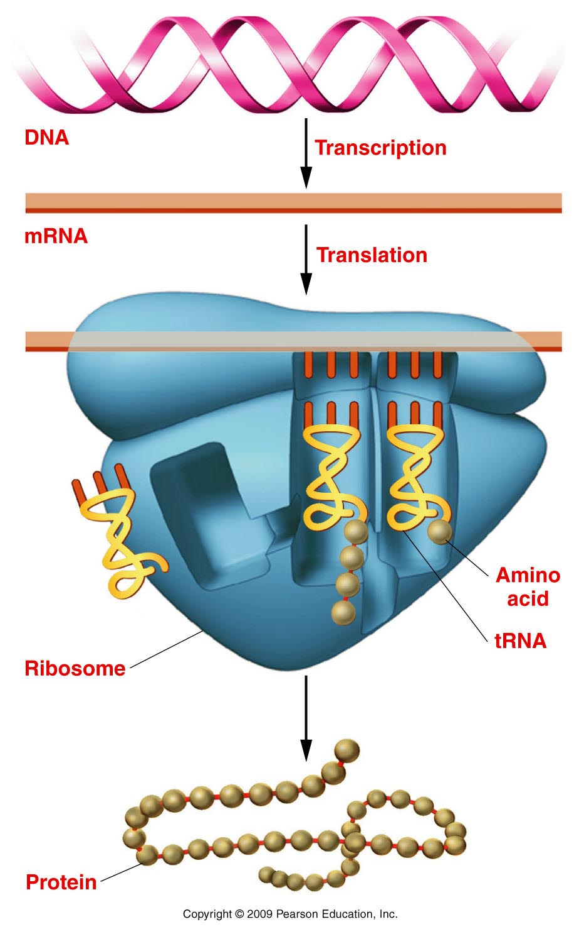
Growth gene
D or d allele
The Central Dogma of Biology
Growth protein D
or d (non functional)
Proteins
Figure 1.9
Notes:
Figure 1-9 Gene expression involves transcription of DNA into mRNA (top) and the translation (center) of mRNA on a ribosome into a protein (bottom).

Slide 5
See other examples…
P.49---A molecular explanation for white flowers (rather than purple) on garden pea plants.
P. 61 explains---at the molecular level, how Mendel’s peas became wrinkled. (Also--handout)
Read, re-read, write /draw it out! (using symbols and the central dogma)

Slide 6
Be able to explain---at the level of a molecule, why some flowers of the garden peas are white, while others are purple.
Ditto—at the level of the molecule, why are some peas smooth, while others are wrinkled.

Slide 7
Mendel’s idea of dominance poses a potential problem…
What is the genotype of an organisms with the dominant phenotype?
e.g. Tall pea plants?
DD or Dd?

Slide 8
Mendel developed a specific breeding experiment to test:
Called a test cross:
test organism X homozygous recessive organism
(organism with dominant trait, unknown genotype.)
Tall plant X dwarf plant
(D ? X dd)
Only 2 possible outcomes:
DD X dd 100% Dd (all tall/dominant trait)
Dd X dd 50% tall : 50 % dwarf (recessive trait)

Slide 9
Be sure to distinguish between a standard Mendelian cross, and a test cross. They are used to answer different questions!
Review and practice all the concepts from todays lecture. Compare them to what you’ve learned about meiosis. Honestly—if you master the concepts from today’s lecture, you will have the foundation for most the rest of the course.

Slide 10
Adding complexity/testing the postulates…
Mendel’s 2-trait crosses (Dihybrid cross)
Same experimental approach:
P X P (true-breeding, differing in 2 traits)
F1 (F1 heterozygote)
F2 (analyze ratios)

Slide 11
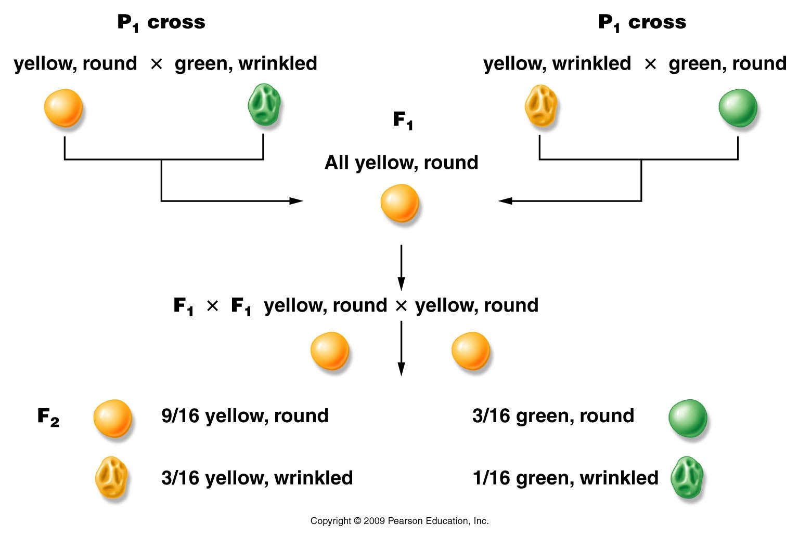
Figure 3.5
Notes:
Figure 3-5 F¹ and F² results of Mendel’s dihybrid crosses between yellow, round and green, wrinkled pea seeds and between yellow, wrinkled and green, round pea seeds.

Slide 12
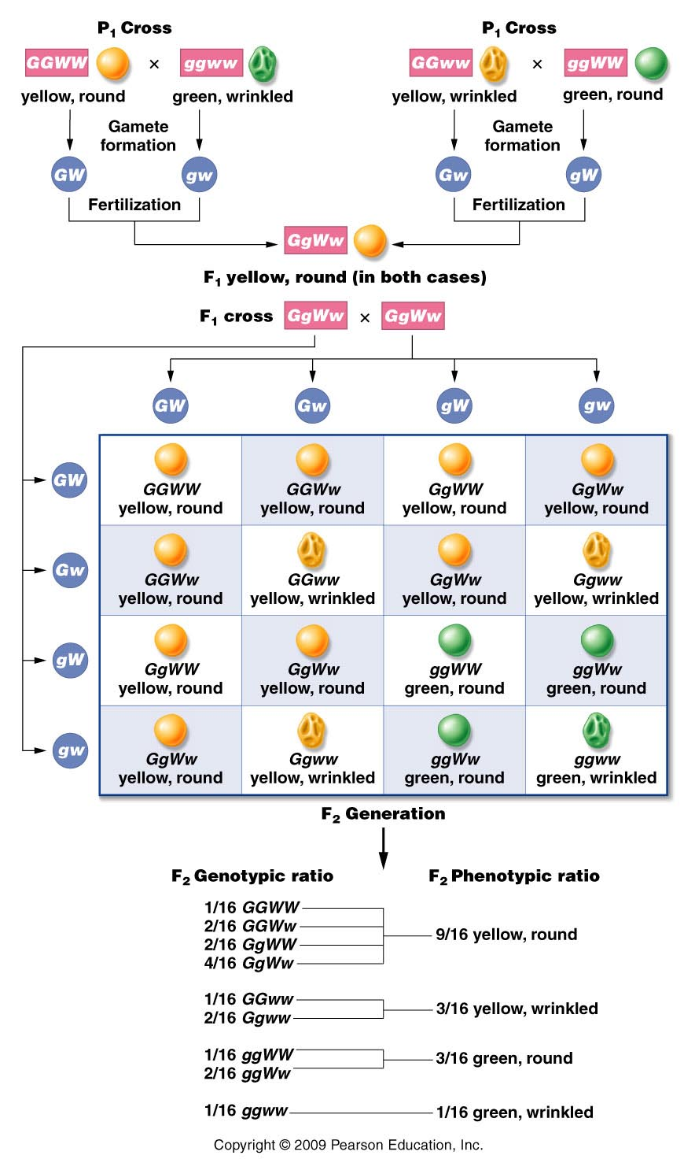
Go back to Mendel’s idea of unit factors.
Assume a different set of unit factors controls color and seed shape.
Use a Punnett square to predict what would happen.
Always apply Mendel’s postulates concerning pairs of unit factors and segregation of pairs during meiosis.
Note the:
9:3:3:1 ratio
Figure 3.7
Notes:
Figure 3-7 Analysis of the dihybrid crosses shown in Figure 3–5. The F¹ heterozygous plants are self-fertilized to produce an F² generation, which is computed using a Punnett square. Both the phenotypic and genotypic F² ratios are shown.

Slide 13
Try it yourself
Design a different dihybrid cross.
Choose proper true breeding parents
Assign symbols accordingly
Show gametes formed by the Parents, then by the F1
Show a punnett square with all combinations of genotypes in the F2 generation. Show corresponding phenotypes.
See if you note a 9:3:3:1 F2 generation ratio.

Slide 14
Mendel’s 4th postulate (could only be stated after dihybrid crosses were performed)
F2 ratios in Mendel’s dihybrid crosses suggested Independent Assortment of unit factors.
During gamete formation , segregating pairs of unit factors assort independently of each other.

Slide 15
Does this sound familiar?
What accounts for this observation?

Slide 16
Does this sound familiar?
What accounts for this observation?
Random alignment of homologous chromsomes during metaphase I of meiosis I followed by random segregation of homologs in anaphase I.

Slide 17
Do Mendel’s postulates relate to what happens in meiosis??
Absolutely!!!
Figure 3.11a
Notes:
Figure 3-11a The correlation between the Mendelian postulates of (a) unit factors in pairs, (b) segregation, and (c) independent assortment, and the presence of genes located on homologous chromosomes and their behavior during meiosis.

Slide 18
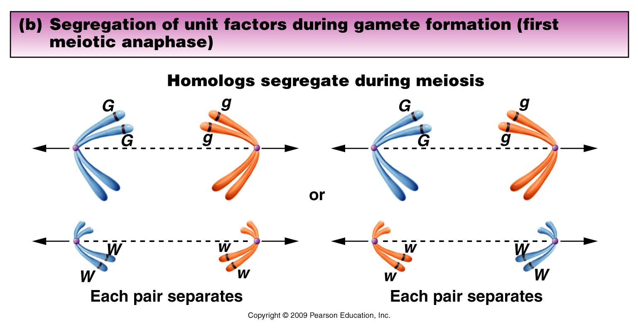
Figure 3.11b
Notes:
Figure 3-11b The correlation between the Mendelian postulates of (a) unit factors in pairs, (b) segregation, and (c) independent assortment, and the presence of genes located on homologous chromosomes and their behavior during meiosis.

Slide 19
F1
GgWw
GW gw Gw gW
Figure 3.11c
Notes:
Figure 3-11c The correlation between the Mendelian postulates of (a) unit factors in pairs, (b) segregation, and (c) independent assortment, and the presence of genes located on homologous chromosomes and their behavior during meiosis.

Slide 20
Dihybrid crosses which analyze traits that are controlled by genes on different chromosomes should show a classic 9:3:3:1 ratio. (Theoretical ratio)
The genes would be called unlinked. We assume the genes controlling pea color and shape are unlinked. Linked genes are located on the same chromosome. We will consider these later!

Slide 21
Back to the testcross concept…
Which traits are dominant in the example?
Which genotypes give you peas with both dominant traits?
How could you identify each genotype in a plant showing the dominant traits?

Slide 22
Try it!
Show how you would set up a test cross for each of the genotypes showing yellow/round peas.
Prove each genotype would give different outcomes in a test cross.
Draw it! Sketch it! Use punnett squares! Possible pop quiz question for the future!

Slide 23
Back to dihybrid cross…
When independent assortment is in operation, dihybrid crosses show a consistent
9:3:3:1 F2 ratio
e.g. in our example: 9/16 yellow round
3/16 yellow wrinkled
3/16 green round
1/16 green wrinkled
F2 ratio

Slide 24
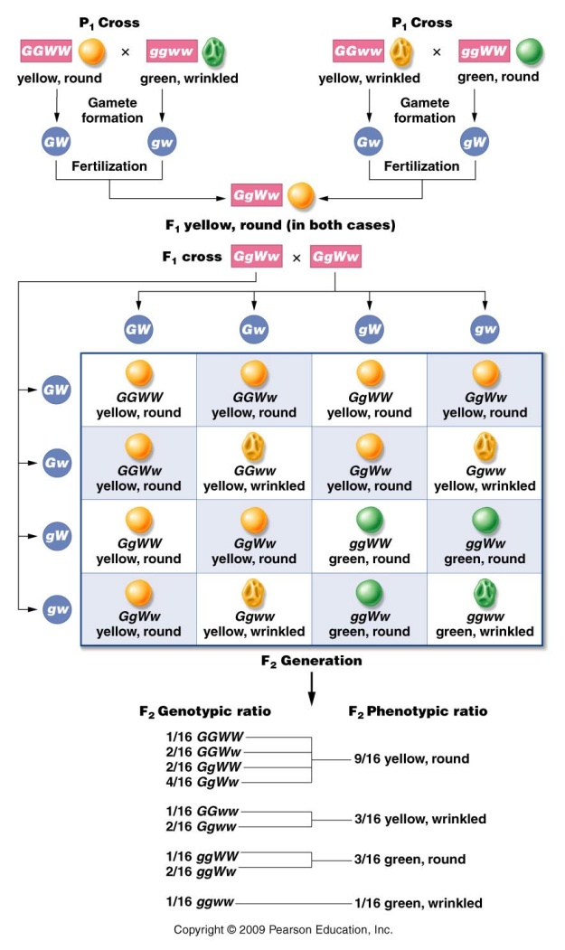
How is this outcome related to the monohybrid F2 ratios?...
Each trait is inherited exactly as it is in a monohybrid cross.
Consider color
and shape separately
(on board)

Slide 25
Start thinking of F2 ratios as expectations/probabilities/expected outcomes
Rule for combining probabilities…
When 2 independent events occur at the same time, the combined probability is the product of each individual probability. PRODUCT RULE
What is the probability of having F2 offspring showing both the yellow and round phenotypes?
(¾ yellow ) (¾ round) 9/16 yellow and round

Slide 26
How about a tri-hybrid (3-factor) cross…
Start to take some shortcuts, being consistent with the rules of Mendelian crosses
P X P (true-breeding parents)
F1 heterozygote (assume independent assortment occurs)
F2 (analyze ratios)

Slide 27
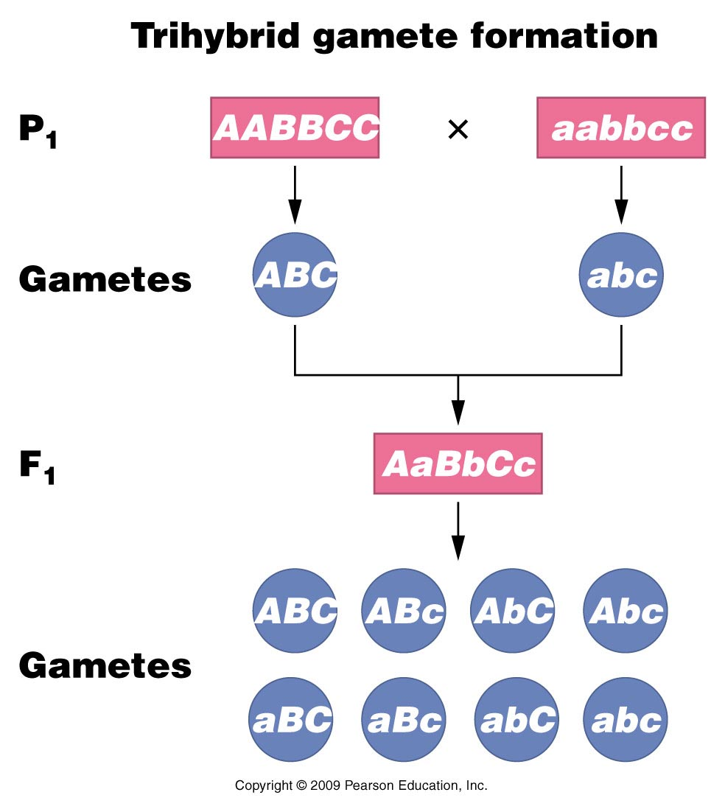
F1 heterozygote—3 unlike pairs of unit factors
Figure 3.9
Notes:
Figure 3-9 Formation of P¹ and F¹ gametes in a trihybrid cross.

Slide 28
How many types of gametes?
2^{n} where n= # of unlike unit factor pairs in the F1 heterozygote.
3-factor cross n=3 so…8 unique types of gametes
Independent assortment!!

Slide 29
How big is your punnett square?
8 types of gametes
8X8=64 entries!

Slide 30
How many different genotypes?
Each factor has 3 possible genotypes.
AA, Aa, aa
BB, Bb, bb
CC, Cc, cc
One possible combo: AA bb Cc
Consider all possible combos…
3^{n}, where n is the # of unlike unit factors. For n=3; 27 unique genotypes.

Slide 31
How many different phenotypes?
Since there are only 2 phenotypes (dominant and recessive)
2³ = 8 different phenotype combinations.

Slide 32
Summarizing
In a 3-point/tri hybrid cross:
8 unique gametes (64-box Punnett square)
27 unique genotypes
8 unique phenotypes
(Table 3.1)

Slide 33
Table 3.1
Notes:
Table 3-1 Simple Mathematical Rules Useful in Working Genetics Problems

